Slide 1

Mental Illness Detection
from Social Media Activities using NLP
Anh Nguyen, Hanna Song
Notes:
our question is “can mental illneses be predicted by studying social media activities”

Slide 2
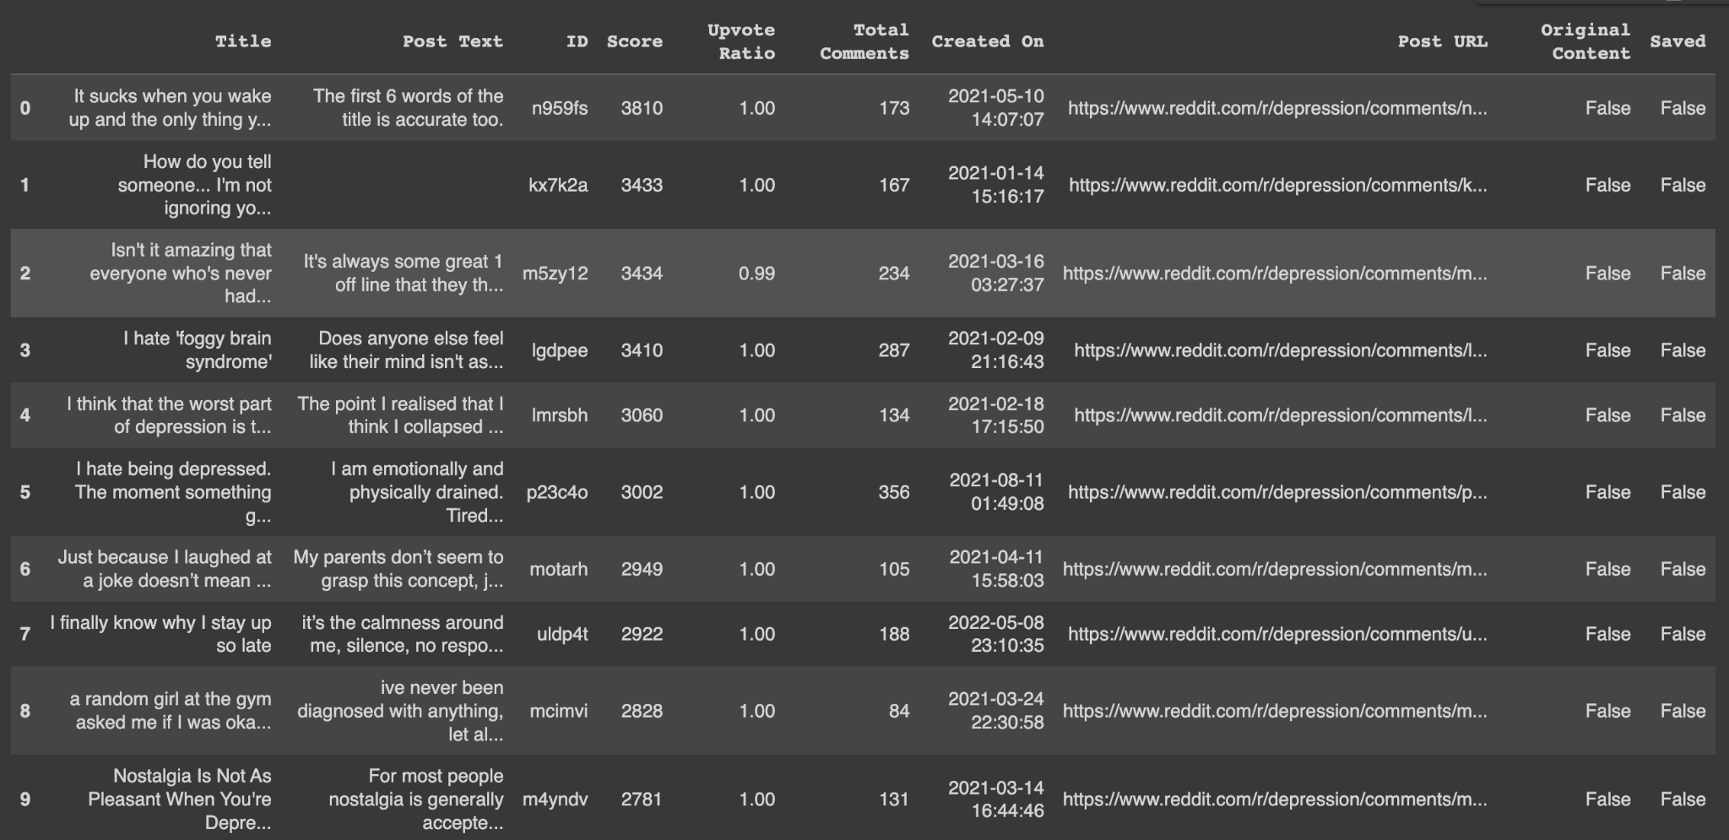
Source of pilot data
Subreddits related to mental health
9 subreddits: Mental health, Mental illness, Health Anxiety, ADHD, Bipolar, Anxiety, depression, PTSD, SuicideWatch

Slide 3
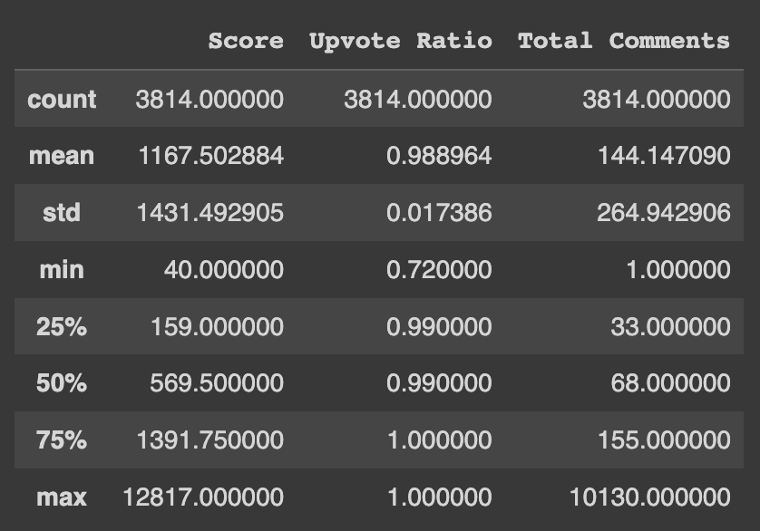
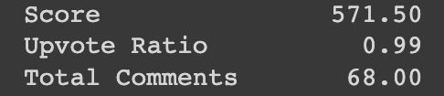
Statistics of the data
Samples include posts from 2021 - 2023 on mental health-related subreddits
Numerical Features:
Score
Upvote ratio
Total comments
on post
median
Notes:
upvote ratio: ratio between upvotes and total votes
people likely to agree and engage on the posts
score: user score that represents how much you've contributed to the Reddit community
highly relevant for
total comments are 68 seems also people are engaging thro posts
this are to prove whether posts are relevant to analyze

Slide 4
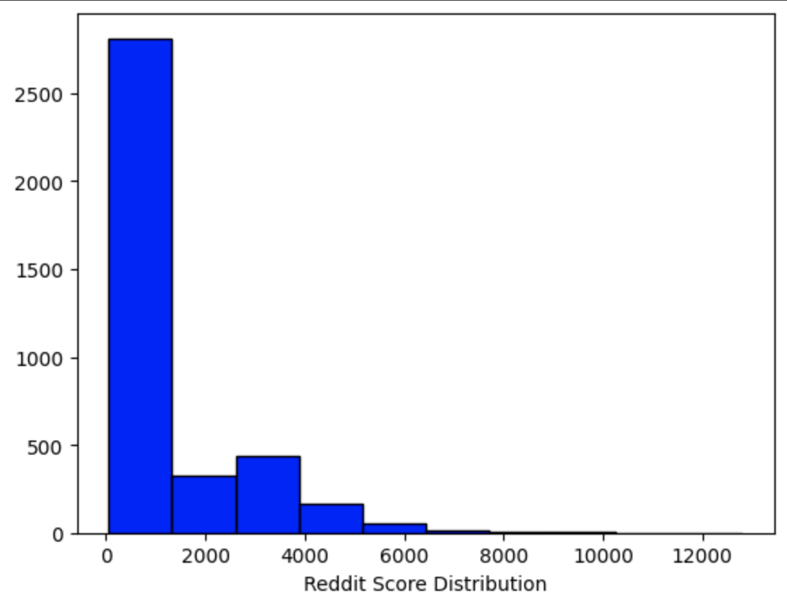
Statistics of the data
Histograms of Reddit Score

Slide 5
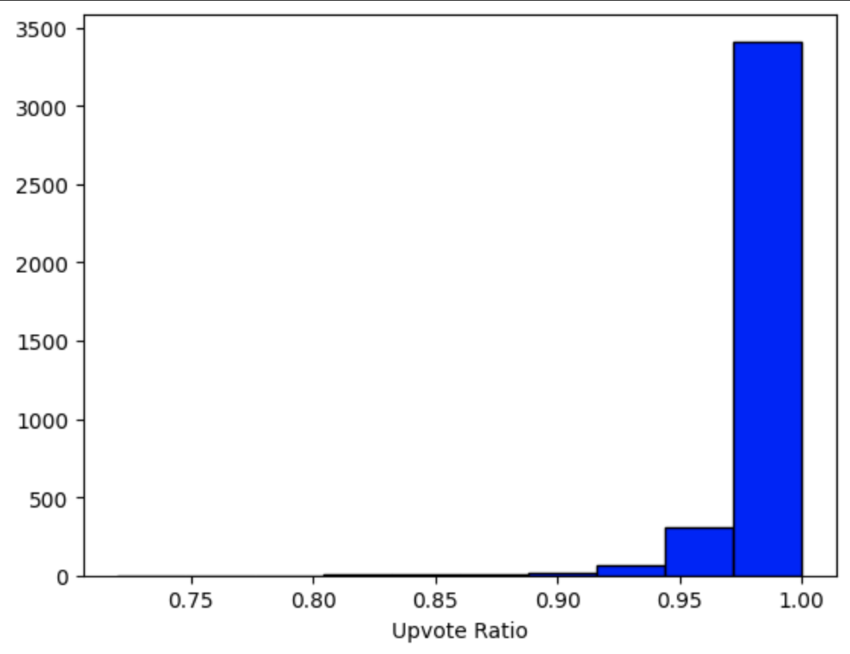
Statistics of the data
Histograms of Upvote Ratio

Slide 6
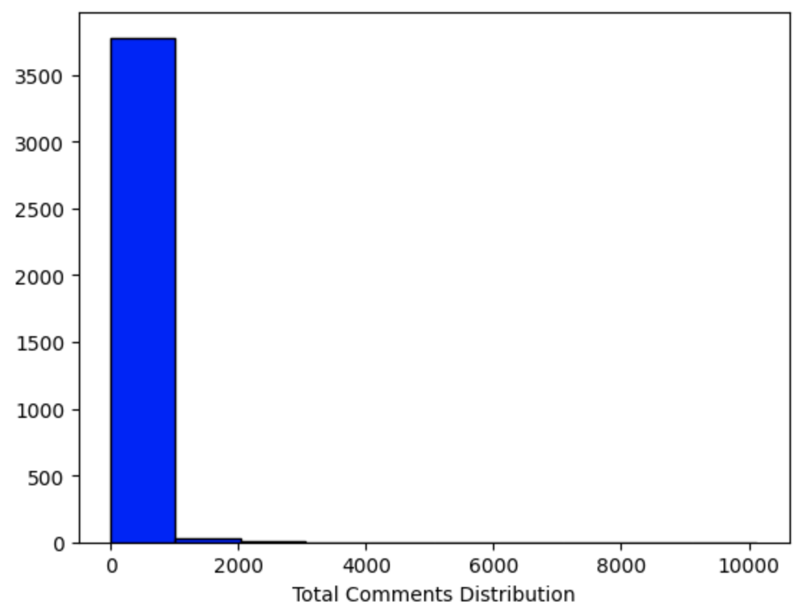
Statistics of the data
Histograms of Total comments

Slide 7
Unit of Analysis
Posts on subreddits related to Mental health
Mental health, Mental illness, Health Anxiety, ADHD, Bipolar, Anxiety, depression, PTSD, SuicideWatch

Slide 8
Theoretical Population
All reddit users’ activities on mental health-related subreddits at any given time
We want to generalize reddit user’s behavior within mental health related subreddits
Notes:
All reddit users post/comment on mental health-related subreddits at any given time
We want to generalize reddit user’s behavior within mental health related subreddits

Slide 9
Accessible Population
Top posts on subreddits related to mental health from 2021 to 2023
Subreddits: mental health, mental illness, suicideWatch, ADHD, Bipolar, Anxiety, depression, PTSD
How to get access:
Use web scraping to collect data directly from the site as Reddit is a public website
Legal as long as we respect regulations such as the GDPR and the CCPA

Slide 10
Sampling Frame
Sampling frame: using pipeline of text classification of Natural Language Processing with keywords that indicate negative emotions or mental health issues people use in posts
Sample: top posts on 9 mental health related subreddits from 2021 - 2023
Level of replication: applying the same NLP classification process to the combined dataset and to each subreddit dataset separately to find similarities and level of replication our dataset
Data point: words from posts

Slide 11
Sample Size
Sample size:
Top posts on mental-health related subreddits (3814 posts) from 2021 to 2023
Since a year of the data is too small to analyze and generalize, we decided to use two years of data
Sampling bias: only some specific mental health-related subreddits are scraped → not a representative of all reddit users with mental health disorders

Slide 12
Threats to the
External Validity
Units: Our sample might not be representative of the population since the data is restricted to specific random subreddits
Place: Data are collected from one place - Reddit
Reddit has specific characteristics that allow people to be more straightforward and comfortable expressing their opinions/feelings. People truly get the pros of being anonymous on here
Time: Limited to 2 years, which may not be representative of all points in time

Slide 13
Probability Sampling or Non-probability Sampling?
Probability Sampling
Our goal: generate a representative sample from a population
Sample: words that individual post on 9 different mental health communities from 2021 to 2023
Population: All Reddit activities regarding mental health at all points in time

Slide 14
Sampling Strategy
Cluster Random Sampling
Collecting Reddit data in 2021-2023 (uniformly) from different random mental health related subreddits and combine them together -> Cluster
Using this combined sample as a representative of the population to draw a conclusion on the relationship between social media activities and mental health detection

Slide 15
Thank You.
Any questions?

